Slide 1
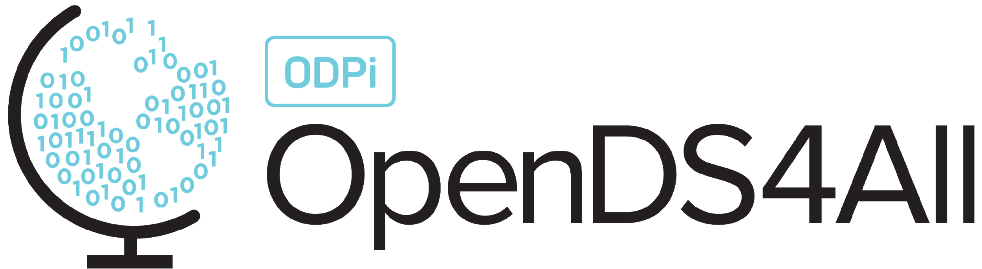
Introduction: What Is Data Science?

Slide 2
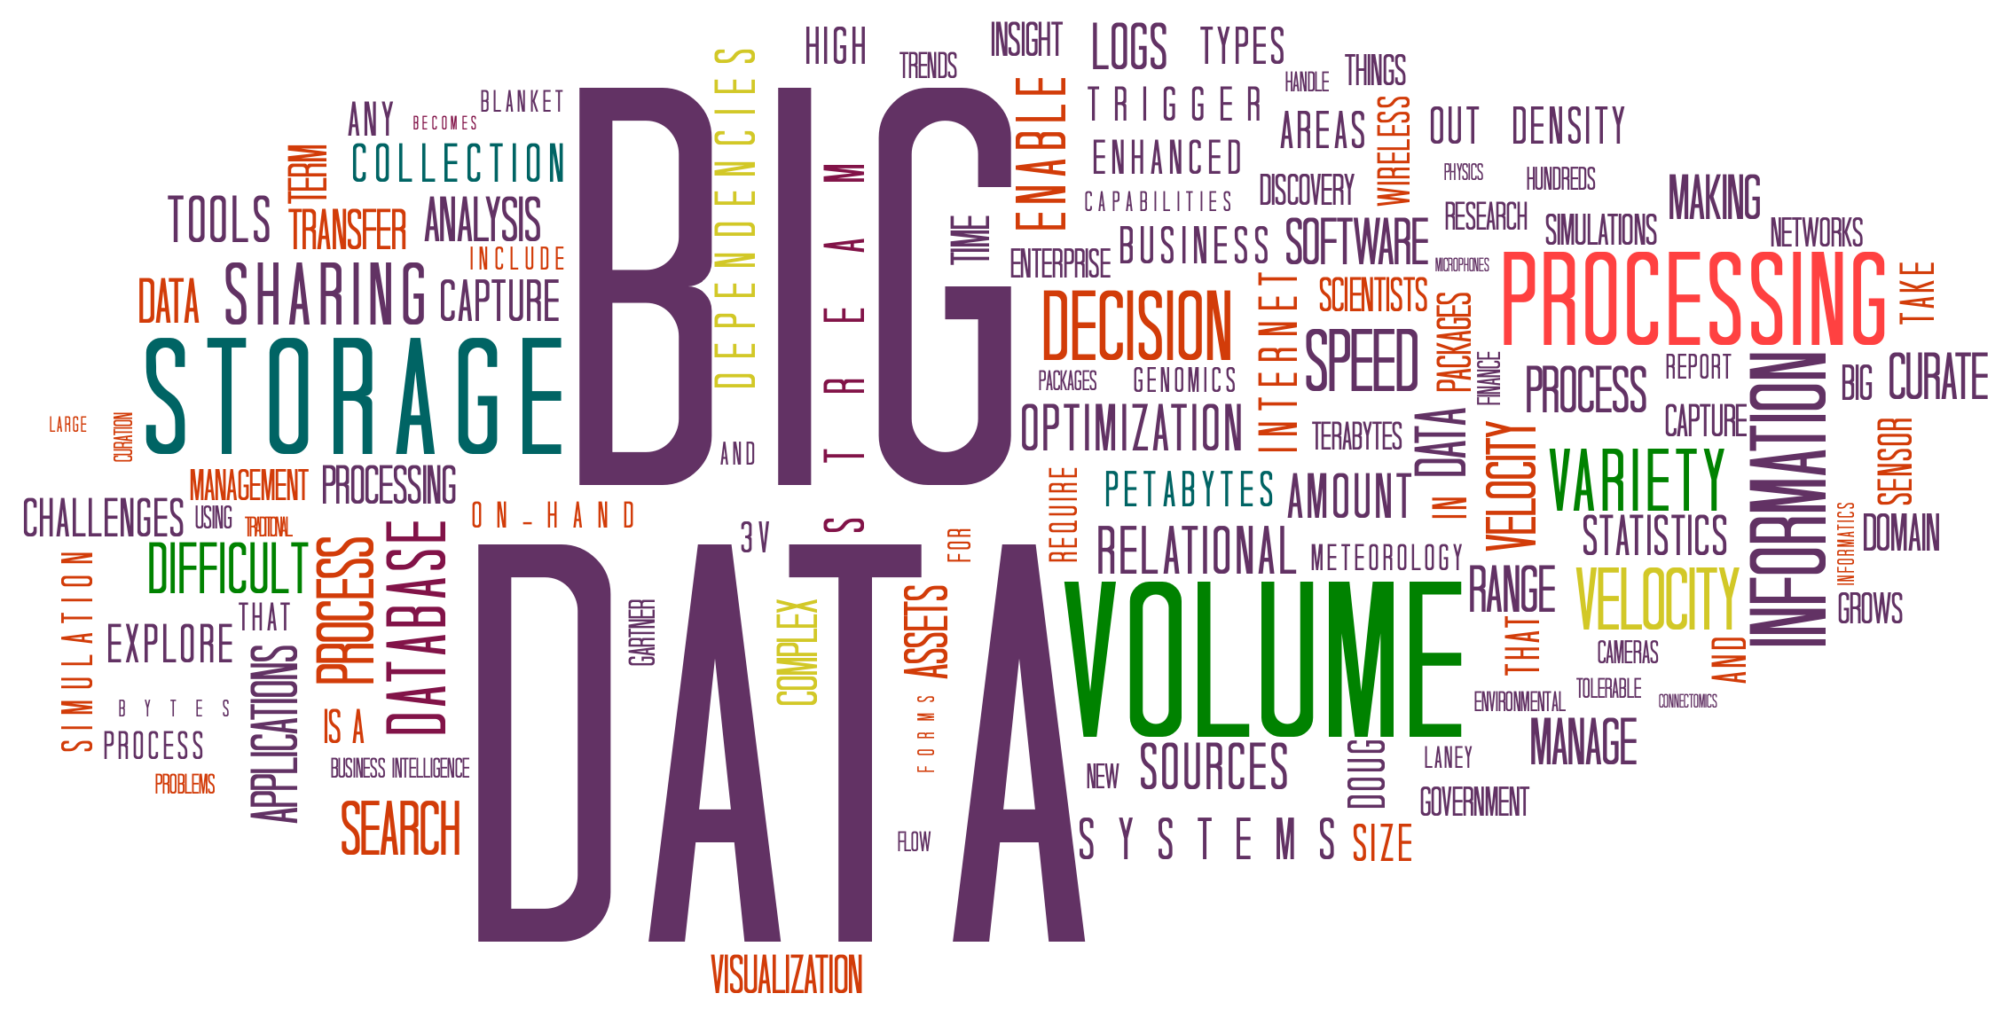
Motivation for the Course: Data Is Driving Everything
Modern data acquisition is inexpensive!
Smartphones, embedded systems, inexpensive sensors,
Medical devices, simulators, …
Data storage is inexpensive!
Parallel (compute cluster) computation is inexpensive
The Cloud, clusters of computers, GPUs, tensor processors, …
Can we use algorithms + data to understand phenomena? Build or augment models? Build detectors? Make diagnoses?
Notes:
There is data everywhere. It is constantly being collected (e.g. through smartphones, IoT sensors, Alexa) and contributed (e.g. through Facebook and Twitter). Storage is cheap, and compute power readily available and rapidly increasing. Computer clusters are available to enable parallelism, and special architectures developed for ML operations. All this is available not just for those who can afford to own them but through the commodity of the cloud..
This increased ability to collect, store and process data has led to a revolution in how we do things in almost every field, from biological sciences to social sciences, humanities, political science, policy, marketing and so on. But just because we have the data doesn’t imply we understand it. It must be processed to derive information, make models, enable predictions, and make diagnoses. We want to use the data to develop (or augment) models using machine learning and other algorithms.
That is the essence of this course.

Slide 3
The Key Question in Data Science: How Do We Explain & Predict the World?
Much of science and engineering derives from physics, where we have rich predictive models
Newton’s laws, the theory of relativity, optics, how materials react under stress, etc.
The basis of prediction tends to be simulation
How do we make predictions where we don’t have good models?
Ee.g., human behavior, biology, the brain, whether a product will be a success, what to invest in
We need to use sampling, statistics, and “data-first” approaches
But we need enough representative data, and the right questions, for good models!
Of course, in the real world we often want to combine models and data!
Notes:
The desire to make sense of the world is not new. In several domains (e.g. physics), well defined models have been developed which have for years been used to make predictions. The novelty in Data Science is the ability to create – or refine -- models in domains where the underlying principles may not be understood.

Slide 4
Outline of Topics
What is data science?
Considerations around big data
What does analytics involve?
Disclaimer and recap
Checkpoint exercises
Practice notebook

Slide 5
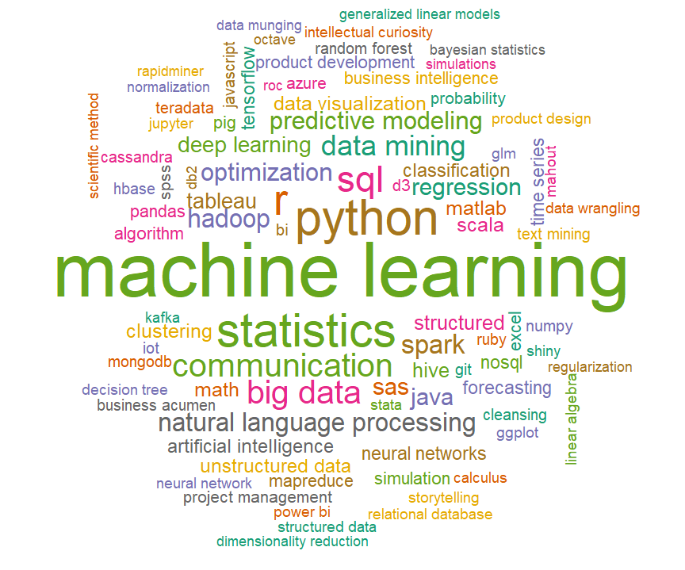
Wordcloud for Data Science
Notes:
If you do a word cloud for Data Science you get something like this. Machine Learning is of course very important, as are statistical techniques, languages (e.g. Python and R), tools (e.g. Hadoop, Kafka), databases (SQL, MongoDB), visualization (e.g. using Tableau and D3), etc.
The idea is that machine learning is part of a much bigger ecosystem, and must be used at scale.

Slide 6

Data Science is Interdisciplinary
(CS+STAT+MATH) ∩
(SCIENCE | ECONOMICS | SOCIOLOGY | BUSINESS | LAW…)
Notes:
Missing in this wordcloud, however, is how inherently interdisciplinary Data Science is. It requires domain experts to understand what/where the data is and what questions are important to ask; mathematicians and statisticians to understand modeling and inference; computer scientists to build systems and design algorithms and methods for analysis; visualization experts and storytellers to effectively communicate results, and policy and legal experts to understand the broader social context, e.g. the ethical implications of a field that has such a dramatic effect on every aspect of our lives (getting a job, job evaluation, what ads are served up, etc).
Data science takes ideas from computer science+math+statistics and applies them (∩) to problems in science, economics, sociology, business, law or …

Slide 7
Data Science Versus Data Analytics and Data Engineering
This course will initially focus on the technical and data manipulation aspects of Data Science, which we will call “Data Analytics”
Some people also call this data engineering
Data Science is much broader, and includes domain expertise, communicating the results to users via storytelling and visualization, and policy and legal implications.
We will get to the broader social context later, e.g. Data Ethics
Privacy, fairness, accountability, transparency, …
We will give examples throughout the course of how data science is used in different domains
Notes:
But of course, understanding the domain well requires an expert – which is outside the scope of this course!

Slide 8
Data Analytics
Our focus – managing and creating models from data at scale:
Complex, heterogeneous, large, high dimensionality, velocity
We will touch on many related techniques and issues
machine learning, distributed computing, distributed algorithms, and parallel computation
We will leverage standard tools and platforms, and point to others
Our focus is on the foundations of machine learning and cloud platforms – you should continue to study these in depth afterwards!

Slide 9
Data and Models
Raw Data
Observations sampled from the world
Structured, Integrated Data
Machine interpretable data
Extracted features
Measurable characteristics
Descriptive or Inferential Model
Of the population as a whole
Parts of the data may be:
In different systems or organizations
Across different documents, databases, etc.
Also, it’s often not in a form where:
We can directly use it, e.g., it’s in text documents or HTML
It’s clean and regular – e.g., it has missing values, spurious values, etc.
Our goal is to extract features that help us make predictions
Notes:
This is the typical workflow for Data Analysis: Raw data is obtained and must be cleaned and regularized. We may also want to complement is using other data which much also must be cleaned and regularized. The data (which may come from different organizations and be in different formats) must then be integrated and put it in a form it which features can be extracted to help make predictions.
We’ll talk about the first two steps next.

Slide 10
Considerations around Big Data: Structure, Cleaning, and Linking

Slide 11
Open and Closed Worlds, Observations vs the Universe
Databases often assume a closed world: we know everything…
The company’s employees, their exact salaries, every product, …
Data science is in an open world: we can’t see the whole population
We are given samples or incomplete observations
We want to predict the future, or characterize the entire population
How we sample affects our model!
There are many pitfalls that can lead to biased models – a topic researchers are trying to address!
As the SEC says: “Past performance is not indicative of future results”
Notes:
Sampling is one of the most important factors in determining the accuracy of results. Is a well studied area that requires collaboration between the domain scientist and statisticians. In Data Science, however, data might be collected for one purpose and reused for other purposes, so there are additional issues of how representative the data is for the given research question. In a later module, we will briefly consider this issue.
For now, we will assume that the data has been collected, and will consider what must be done to put it in a form in which analysis can be performed.

Slide 12

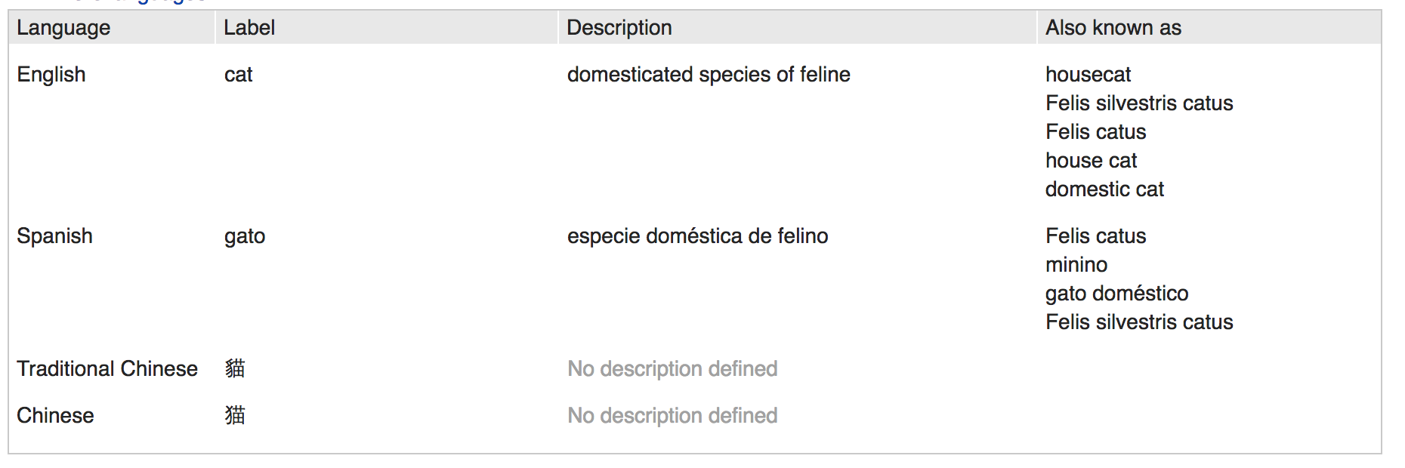

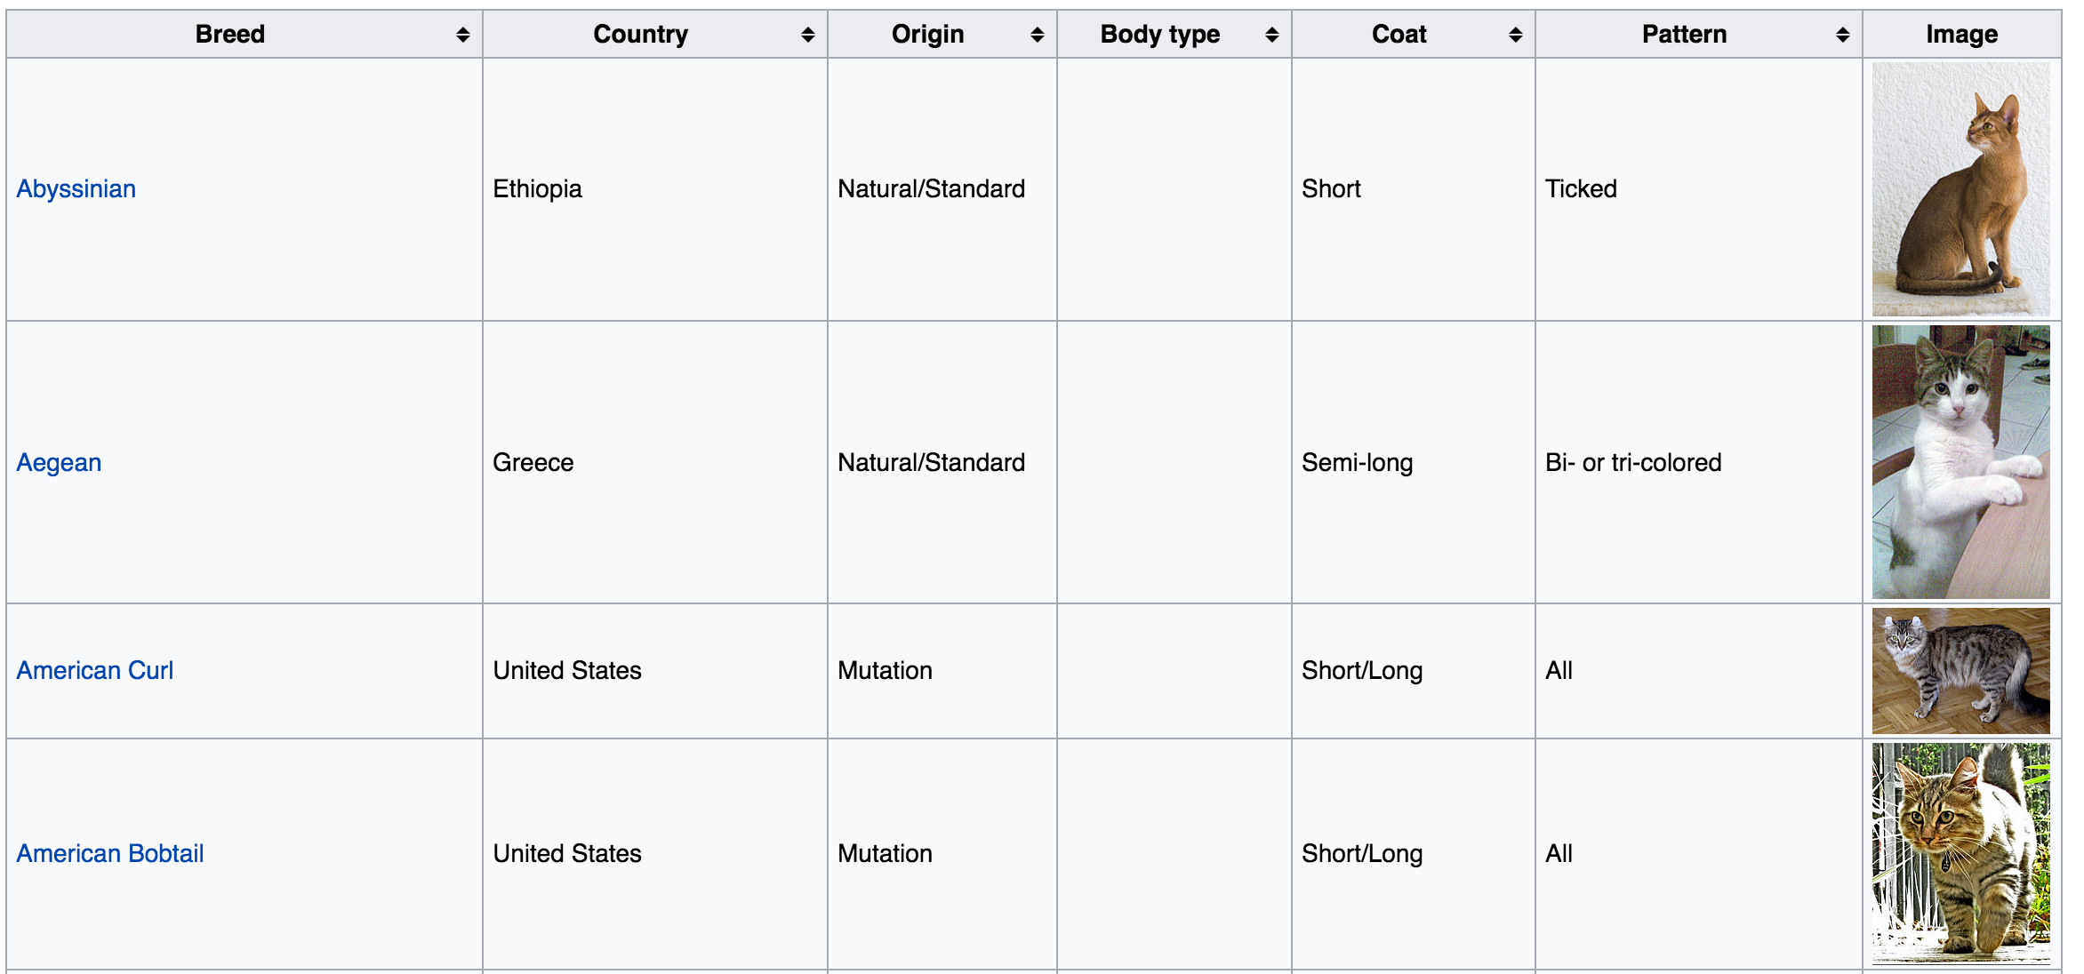
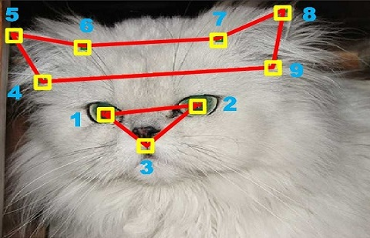
Raw Data vs Structured Data
Images
Data +
feature
extraction, wrangling
Genes
Text
Do not be like the cat who wanted a fish
but was afraid to get his paws wet.
William Shakespeare
Notes:
Let’s take the popular example of cats – everyone loves information you can find about cats on the internet!
For example, there are images, genomic information, articles about cats (free text and/or semi-structured information).
We want to be able to bring it all together, wrangle it, and bring it into a form that can, for example, be used to develop a model for recognizing various types of cats.
Credits: Wikipedia, https://people.eecs.berkeley.edu/~junyanz/cat/cat_papers.html,

Slide 13
Raw Data vs Structured Data
Images
Data +
feature
extraction, wrangling
Genes
Text
Goal: raw data to structured data
Fields, entities, objects, machine learning features
May be very regular or semi-structured
Ultimately, goal is to go from data to information to knowledge
Do not be like the cat who wanted a fish
but was afraid to get his paws wet.
William Shakespeare
Notes:
The goal is to take raw data into structured data, over which analysis can be performed to create knowledge.

Slide 14
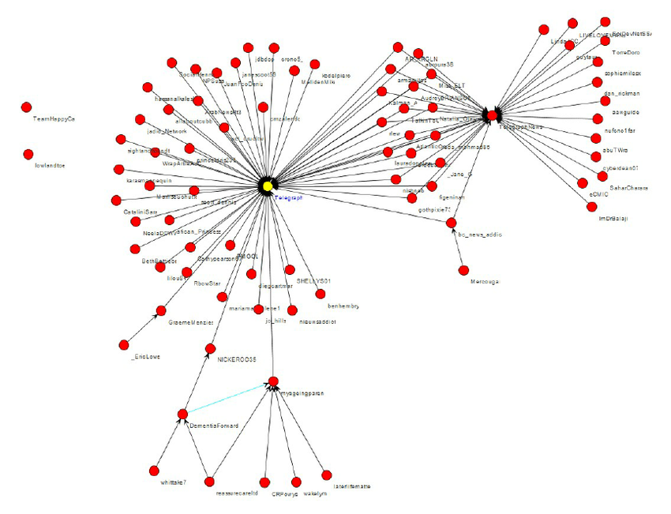
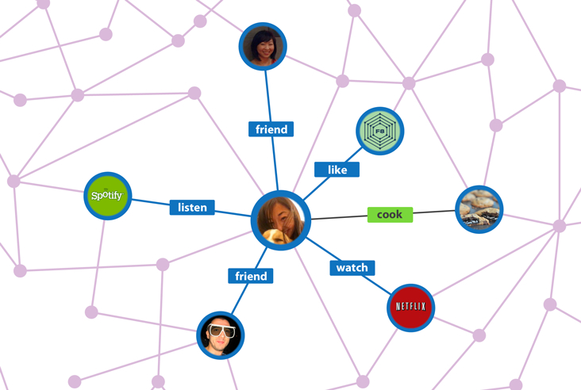
Linked Data: Find Patterns in Connectivity (Clusters, Paths, …)
Notes:
We’ve been talking a lot about “entities” (real world objects) and features of entities, but sometimes it is the relationships between entities that are important (e.g. friend relationships in Facebook). We commonly represent relationships between entities as a graph, with nodes being the entities and edges being the relationships. We can then use the relationships to make recommendations, for example, who you might friend, or what type of music you might like to listen to. In doing so, you might look at properties of enties as well as paths between entities, or connected components of entities. So there are a lot of algorithms that we might want to run over these graphical models. This applies well beyond social networks to areas such as genomics.
Facebook graph: https://www.google.com/url?sa=i&rct=j&q=&esrc=s&source=images&cd=&cad=rja&uact=8&ved=0ahUKEwiG-NS3pszYAhUiYt8KHUMFCH4QjRwIBw&url=http%3A%2F%2Fwww.businessinsider.com%2Fexplainer-what-exactly-is-the-social-graph-2012-3&psig=AOvVaw2D5Cm84V0EKbfEKCIh2EYF&ust=1515635983002846
Retweet graph: https://www.researchgate.net/figure/266968024_A-sample-basic-retweet-graph

Slide 15
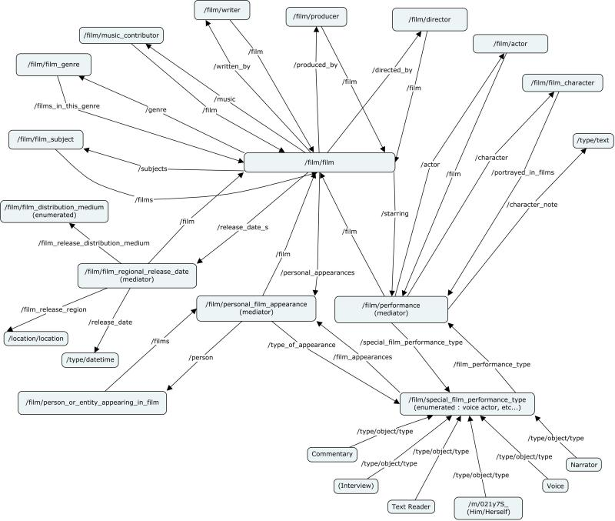
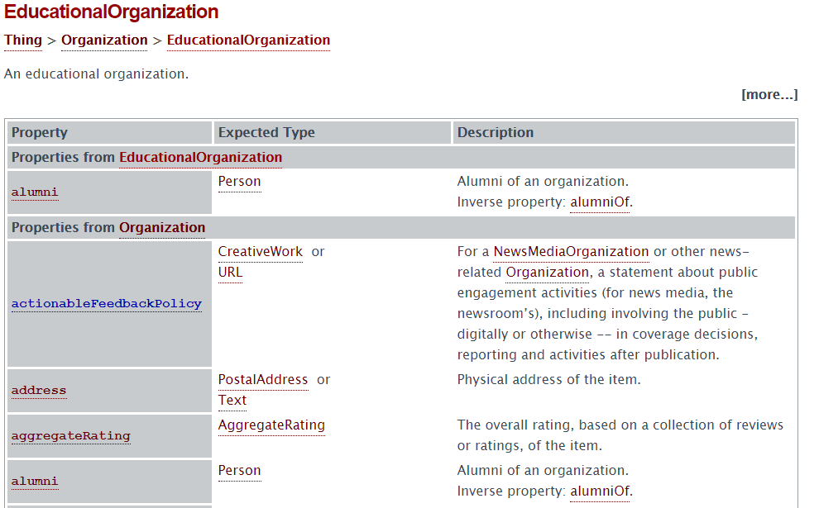
Data with Complex Semantics: Knowledge Graphs
Classes, subclasses, instances, and properties
Notes:
There’s another type of graphical structure that is important called “knowledge graphs”. This is the centerpiece of what Google uses to aid search. It captures the concepts of a domain and the relationships between those concepts. For example, not shown in this image, we might have Barack Obama and Donald Trump at the leaves of a knowledge graph, and we know that there are certain things that those two people have in common, e.g. being president. Being president is a concept we could have in the knowledge graph, with Obama and Trump both being instances. We could also talk about some of their dissimilarities, e.g. being in different political parties. You can use the knowledge graph to disambiguate, and impose structure over the entities.
For example, a knowledge graph can and is being used to improve search. Suppose we are searching for Michael Jordan, and there are several different people named Michael Jordan (e.g. basketball player, actor, machine learning researcher). How does the system know which one you are talking about? There is a lot of information about you that your browser has been collecting: It could look at your search history and decide which one you are most likely to be interested in, e.g. Michael Jordan the machine learning researcher.
Freebase figure from: https://dzone.com/articles/associative-data-modeling-demystified-part-iv
EducationalOrganization from schema.org

Slide 16
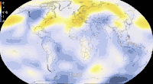
Dynamic, High-Velocity Data: Track over Time, Forecast the Future
Notes:
A third type of data that we will be talking about during the course is temporal data (which is also called timeseries or streaming data). Here we are not primarily interested in entities or relationships between entities, but how the data changes over time. In this image we are showing temperature data as it changes across the globe, which could be important if we are studying climate change. For example, we might worry about how the temperature in the ocean is rising and what the effect is over the ecosystem.
https://giphy.com/gifs/climate-change-visualization-global-warming-hPovBcQ3c1g9W

Slide 17
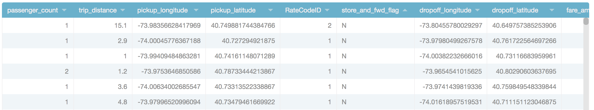
Tabular (Relational) Data and Joins / Lookups (e.g. to Web Services)
New York Taxi Data
Notes:
Finally we should talk about tabular data. For example city governments are collecting a lot of data and making it publicly available, e.g. parking ticket and accident data. Frequently, questions you want to ask involve linking this data to other data. For example, here we have taxicab data with information about trips that people have taken, e.g. a taxi picked up a person and drove them for 15.1 miles. It also shows latitude-longitude data. You can infer certain things from this, such as the average length of trips, or the most frequent pickup location based on latitude-longitude. However, you can learn even more if you combine it with other information.
https://data.cityofnewyork.us/Transportation/2015-Yellow-Taxi-Trip-Data/ba8s-jw6u
Up next: How big? (Z)

Slide 18
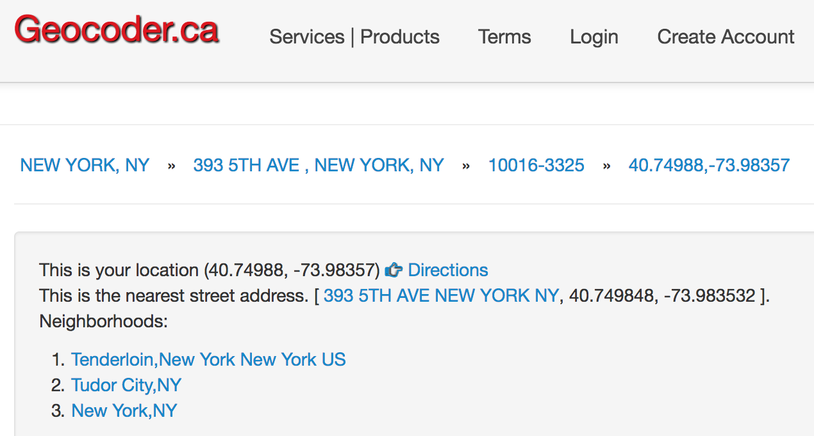
Tabular (Relational) Data and Joins / Lookups (e.g. to Web Services)
New York Taxi Data
Reverse Geocode Data
Notes:
For example, Geocoder will take latitude-longitude and give street address information, which might be more meaningful to you.
https://data.cityofnewyork.us/Transportation/2015-Yellow-Taxi-Trip-Data/ba8s-jw6u
Up next: How big? (Z)

Slide 19
Tabular (Relational) Data and Joins / Lookups (e.g. to Web Services)
New York Taxi Data
Reverse Geocode Data

Slide 20
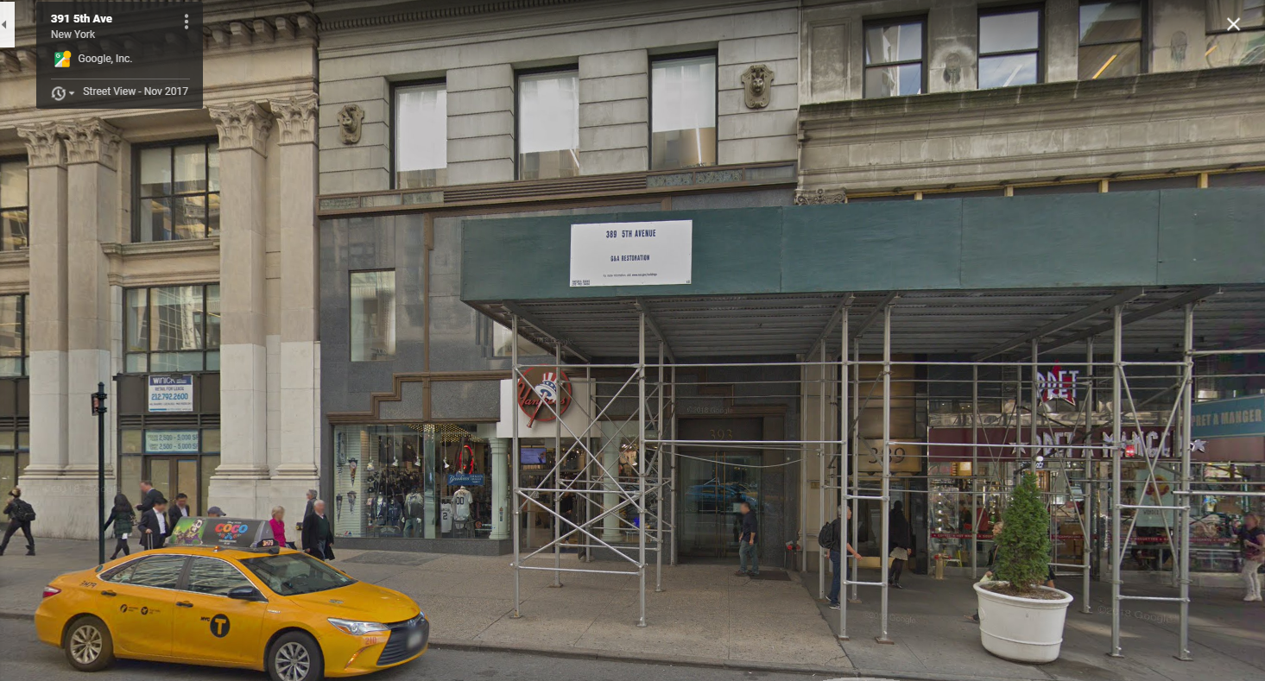
Tabular (Relational) Data and Joins / Lookups (e.g. to Web Services)
New York Taxi Data
Reverse Geocode Data
Street View
Notes:
You can go even further and use Google maps to visualize the location (see here that there is even a taxicab in the image!)
https://data.cityofnewyork.us/Transportation/2015-Yellow-Taxi-Trip-Data/ba8s-jw6u

Slide 21
What Makes Data “Big” Data?
A gigabyte? A petabyte? A yottabyte?
A Million records? Billion records? Trillion records?
There is no consensus definition, but from our perspective:
Too complex for a human to understand directly
Doesn’t fit into a single uniform memory space (e.g. variables in Python) – means we need to think carefully about I/O and/or communication
Need more than brute force algorithms to analyze
May require multiple computers to work in parallel to process
Possibly high dimensionality, requiring feature selection and dimensionality reduction
May be changing rapidly (high velocity)
Notes:
In Data Science, the focus is on Big Data.
So what is it that really makes data “big”? Of course the size matters: it may be too big for an Excel spreadsheet, or too big for the main memory in your computer. But It is also the heterogeneity of data (e.g. data being combined from images, free text and structured sources), and the fact that the data may also be rapidly changing or streaming, requiring a different type of processing.
Even if we focus just on size, there are issues that must be addressed: Observe that size is affected by both the number of rows (or observations) as well as the number of columns (or features). When the number of rows is very big, you cannot just use a brute force or naïve algorithm, you have to worry about efficiency; it may also require you to use parallelism to speed up computation. When the number of columns is big, you may have to reduce the number of features using feature selection and dimensionality reduction. These ideas will be discussed in detail later, but:
Feature Selection is the process where you automatically or manually select those features which contribute most to your prediction variable or output in which you are interested.
Dimensionality reduction is the process of reducing the number of random variables under consideration by obtaining a set of principal variables.

Slide 22
What Does Data Analytics Involve?

Slide 23
The Goal of Data Analytics: From Data to “Knowledge” or Action
Pattern detection: Raw data ⇒ patterns ⇒ partial understanding
“Show me sales by region by product category”
“Show me clusters of documents by concept”
“Data cubes” (sales by region by quarter by type of product)
Typically, descriptive statistics
Given an observation: Hypothesis ⇒ experiment over sample ⇒ significance
“Behavioral factor F leads to higher risk of outcome O”
Do statistical test, measure significance vs. null hypothesis
Typically, inferential statistics
Notes:
Once you have something in a form that it can be read, the next step is to understand the data and look for patterns. You may do this by hand, or use visualization tools to get an idea of what the data is about.
Once you understand more about the dataset, you make a hypothesis. To test the hypothesis you may need to obtain additional data (find/collect more data, run an experiment that generates more data about the truth of the hypothesis).
Finally you use statistics and test if the hypothesis is valid.
The typical pipeline is at the bottom of the page. Sometimes the apply step is linked back to the collection step, and ends at the extrapolate step. ML is in the recognize and build steps.

Slide 24
What Does Big Data Analytics Involve?
Acquisition, access – data may exist without being accessible
Wrangling – data may be in the wrong form
Integration, representation – data relationships may not be captured
Cleaning, filtering – data may have variable quality
Hypothesizing, querying, analyzing, modeling – from data to info
Understanding, iterating, exploring – helping build knowledge
And: ethical obligations – need to protect data, follow good statistical practices, present results in a non-misleading way
Notes:
Some of the activities involved in analytics are listed here, annotated with the steps in the pipeline in which they appear.
And a very important part of analytics are the ethical issues, which must be considered at each step along the way in this pipeline.
The last issue is what questions should I be asking? What applications make sense? It is easy to get data, but hard to do something useful with it.

Slide 25
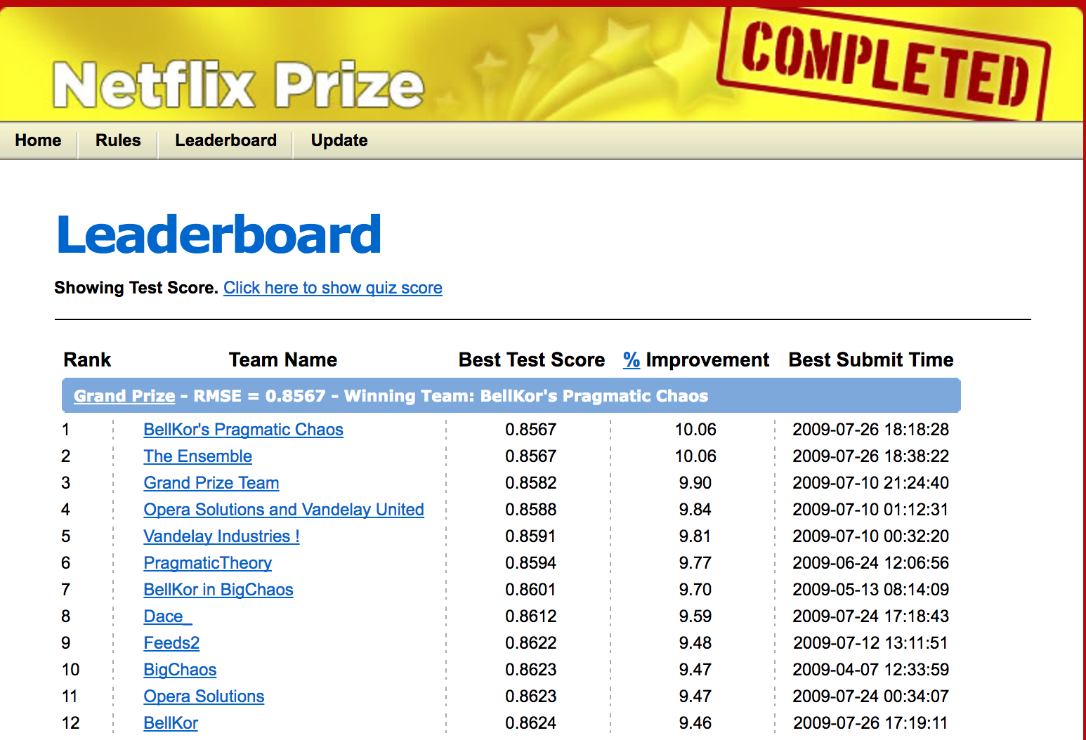
Example: Netflix Recommendation (Or Amazon, Or Personalized Search, Or …)
Notes:
One of the first data science problems posed to the community at large, from about a decade ago, was called the “Netflix Prize.”
Netflix wanted to improve video recommendations for their customers.
Netflix shared “anonymized” data with the public and asked for solutions, with a $1M prize. At that point, users would rate a movie from 1-5 stars.
There was a lot of available data here: structured information about the movies, titles, actors, other people’s ratings, text descriptions, and so on. Each person working on the challenge extracted different “features” used them in various ways to make predictions, using techniques from natural language processing (over text), machine learning, and a related technique called collaborative filtering.
But the Netflix Challenge ultimately revealed another issue that we always need to consider in the data science space: it turned out that clever researchers were able to correlate the anonymous Netflix viewership information with reviews posted (with IDs) to the Internet Movie Database, and reverse engineer who many of the viewers were!
So in many ways the Netflix Challenge is a microcosm of the kinds of issues one encounters in data science: techniques to extract the right features, techniques for machine learning, computing at very large scale, and being very cognizant of data privacy and other ethical issues.

Slide 26
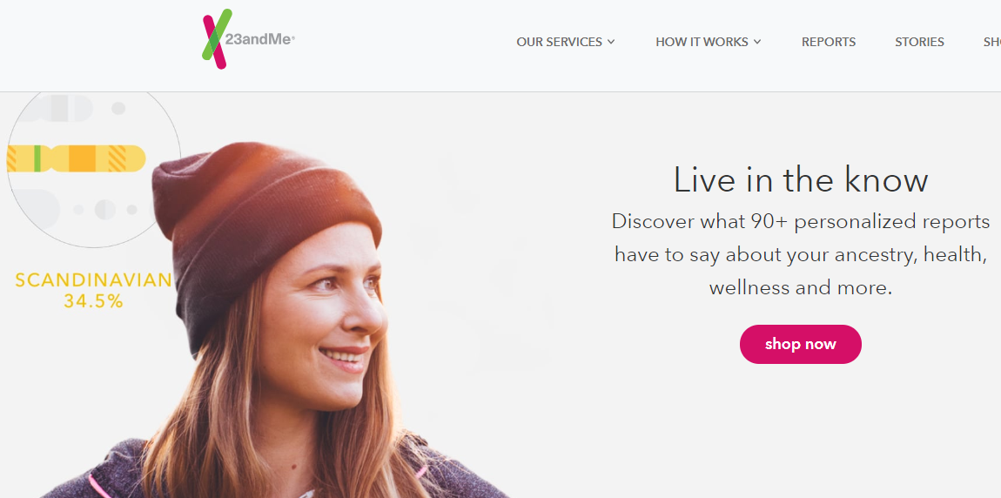
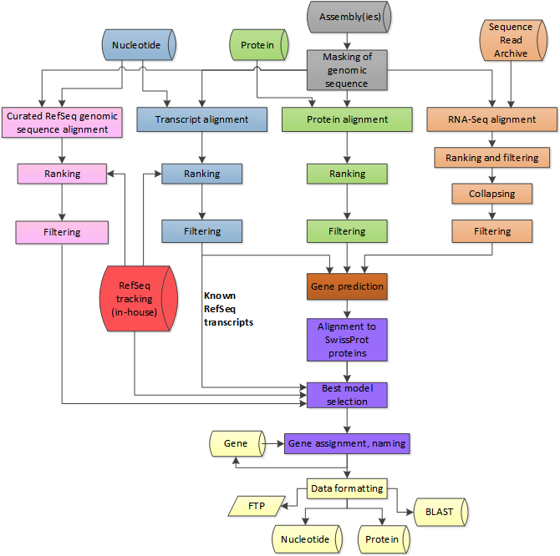
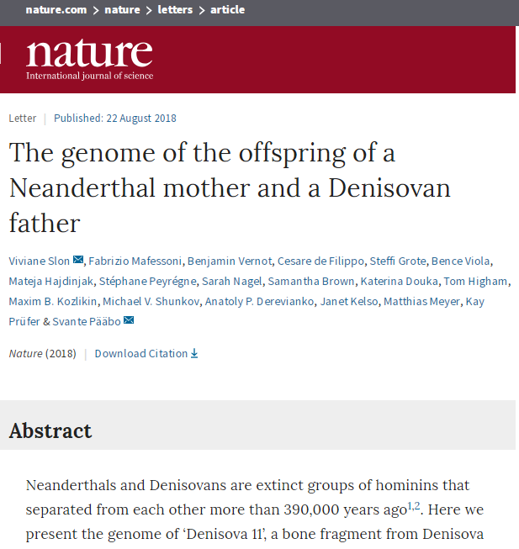
Example: High-Throughput Gene Sequencing
23andme.com
https://www.ncbi.nlm.nih.gov/genome/annotation_euk/process/
Notes:
As another example, Genomics (computational biology) was an early example of Data Science. It was the “putting a man on the moon” grand challenge of the 1990’s. Over the decades, innovations in technologies to collect genomic information have provided a tremendous amount of data, and algorithms and techniques have been developed for its analysis. This was a precursor for what is now happening in many different fields across humanities, political science, economics, etc.
High-throughput gene sequencing allows us to capture vast amounts of DNA and use it to do interesting things, e.g. the types of analysis that is being performed by companies such as 23andme.
This information also enables other things, such as personalized medicine (i.e. developing treatment plans for individuals rather than a generic treatment plan).
An example of the pipeline for its analysis is shown on the right, which performs the wrangling discussed earlier, align with other data banks, and make predictions.

Slide 27
Data Science / Data Analytics: Beware Over-Hyped Expectations!
Data science myth:
We’ll learn everything “bottom up” using fancy statistics and machine learning
Basically we “turn the crank” and out pop insights!
Data + algorithms 🡪 knowledge
Data science reality:
We’ll typically rely on human expertise to impose models over the data, the features, etc.
Deep learning can do feature selection – but why throw away what we know!
Data + human insight + algorithms + iteration → information → knowledge
Notes:
Data science requires human insight, in particular by the domain scientist. It is not just turning the crank using statistics and machine learning!

Slide 28
Data Science Application Process
What question are you answering?
What is the right scope of the project?
What data will you use?
What techniques are you going to try?
How will you evaluate your results?
What maintenance will be required?
Notes:
Here are things that you should consider when embarking on a data science project.

Slide 29
Disclaimer and Recap

Slide 30
A Word from Practitioners in Data Science
At least 80-90% of their work involves not machine learning, but:
Working with experts to understand the domain, assumptions, questions, etc.
Trying to catalog and make sense of the data sources
Wrangling, extracting, and integrating the data
Cleaning the wrangled data

Slide 31
Recap: What Data Science Involves
Data is high-dimensional, hard to understand, and requires an understanding of computation and I/O costs.
Given an integrated dataset (often the hard part!), data science involves extracting and selecting features, as well as adding semantic structure to the data.
There are many applications of Data Science, from discovery to clustering to classification to recommendation!
Sometimes statistical, sometimes algorithmic, and sometimes reliant on extraction

